Slide 1
Opensouce is in our genes
SUSE Beijing R&D
2014-03-14

Slide 2


Freedom
Contribution
Share
Fair
License
Community
Evolution
Inheritance
Platform
SUSE
Soil

Slide 3







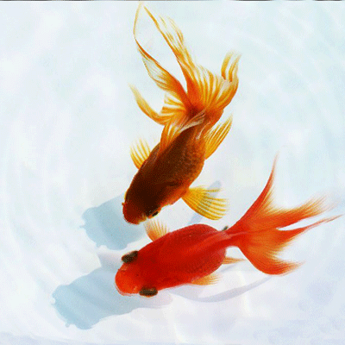









Linux
Gnome
Xen

Slide 4
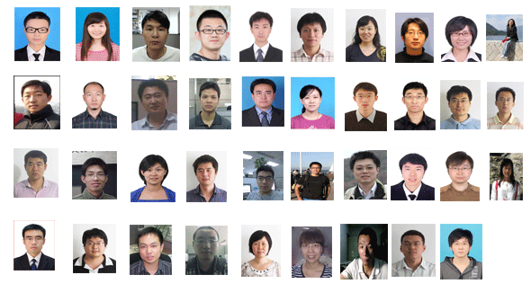



Slide 5
Produced By
Producer：Chen Ri Li
Screenplay: Zhang Jian
Editing：Liu Chun Yan, Jin Xiao Jun, Mu Lei
Cinematography: Wang Jun
Studio：Hao Jun Wei

